Slide 1
WELCOME TO OUR PRESENTATION

Slide 2

BABULAL TARABAI INSTITUTE OF RESEARCH AND TECHNOLOGY, SAGAR(M.P)
MINOR PROJECT ON
TIC TAC TOE GAME
PRESENTED BY:-
MONIKA CHOUDHARY (0608CS211031)
ARYAN KESHARWANI (0608CS201008)
KSHITIJ SONI (0608CS201026)
SIDDHI NEMA(0608CS201059)
(CSE 5tH SEM)
PRESENTED TO:-
CSE DEPARTMENT

Slide 3
CONTENTS :-
Introduction to tic – tac – toe .
Minimum System Requirements .
Functions .
Header files .
Game interface .
Sample output 1 .
Sample output 2 .
Future scope .
Conclusion .
References .

Slide 4

Introduction to tic-tac-toe :-
This game is very popular and is fairly simple by itself. It is actually a two player game . In this game , there is a board with n X n squares. In our game , it is 3 X 3 squares.
The goal of Tic Tac Toe is to be one of the players to get three same symbols in a row horizontally , vertically or diagonally – on a 3 X 3 grid.
In this game , players soon discover that best play from both the parties leads to a draw . Hence Tic –Tac – Toe is most often played by young children .

Slide 5
MINIMUM SYSTEM REQUIREMENTS :-
OPERATING SYSTEM:- Windows 7, 8, 10, 11
CPU:- Intel i3
RAM:- Minimum 2GB
STORAGE:- At least 150GB
PROGRAMMING LANGUAGE USED:- C++

Slide 6
Functions :-
printInputMatrix( ) : this function prints the input matrix of 3 X 3 with having field’s name mentioned in that particular field.
printBoard( ) : this function prints the whole Tic – Tac – Toe grid of 3 X 3 .
addMark( ) : this function is used to add mark to particular fields chosen by the players .
check( ) : this function checks if any of the players has won the game or not , it is also used to check if the game is draw .

Slide 7
HEADER FILES USED IN GAME:-
#include<iostream.h> : iostream stands for standard input-output stream. This header file contains definitions of objects like cin, cout, etc.
#include<conio.h> : The conio stands for Console-Input-Output. The conio.h is a non-standard header file used in C and C++ programming. This file contains console input-output functions which are mostly used by MS-DOS compilers. This header file contains definitions of funtions like getch( ) , clrscr ( ) , etc .
using namespace std ; : a namespace is a collection of related names or identifiers (functions, class, variables) which helps to separate these identifiers from similar identifiers in other namespaces or the global namespace.

Slide 8
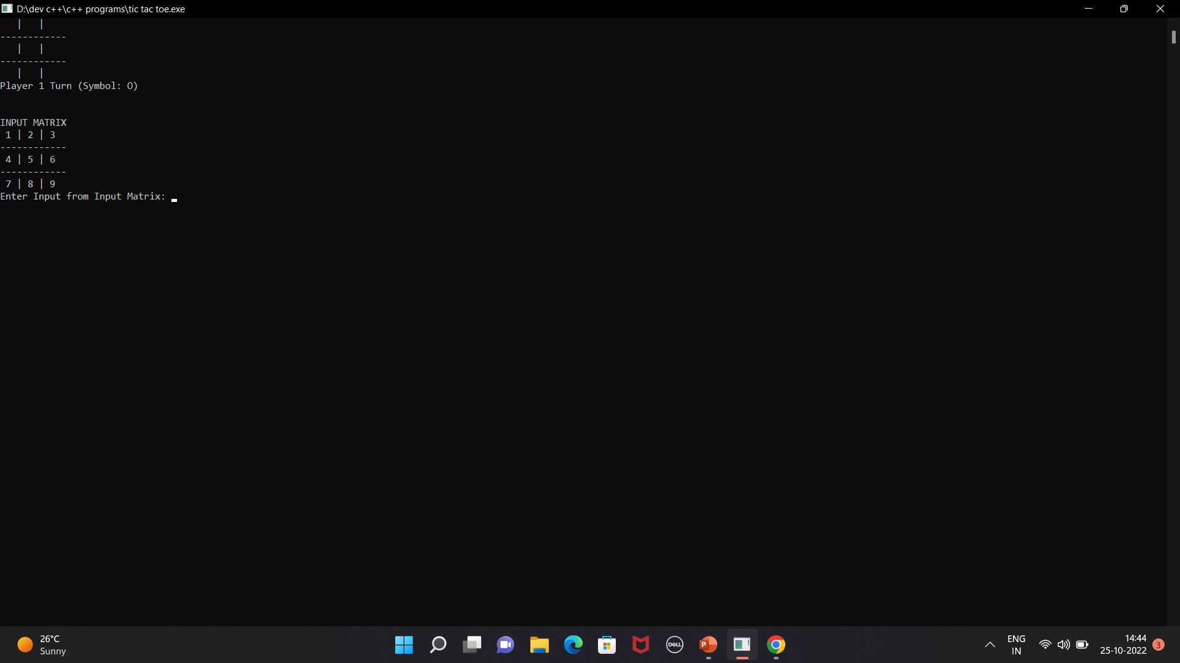
Game interface :-

Slide 9
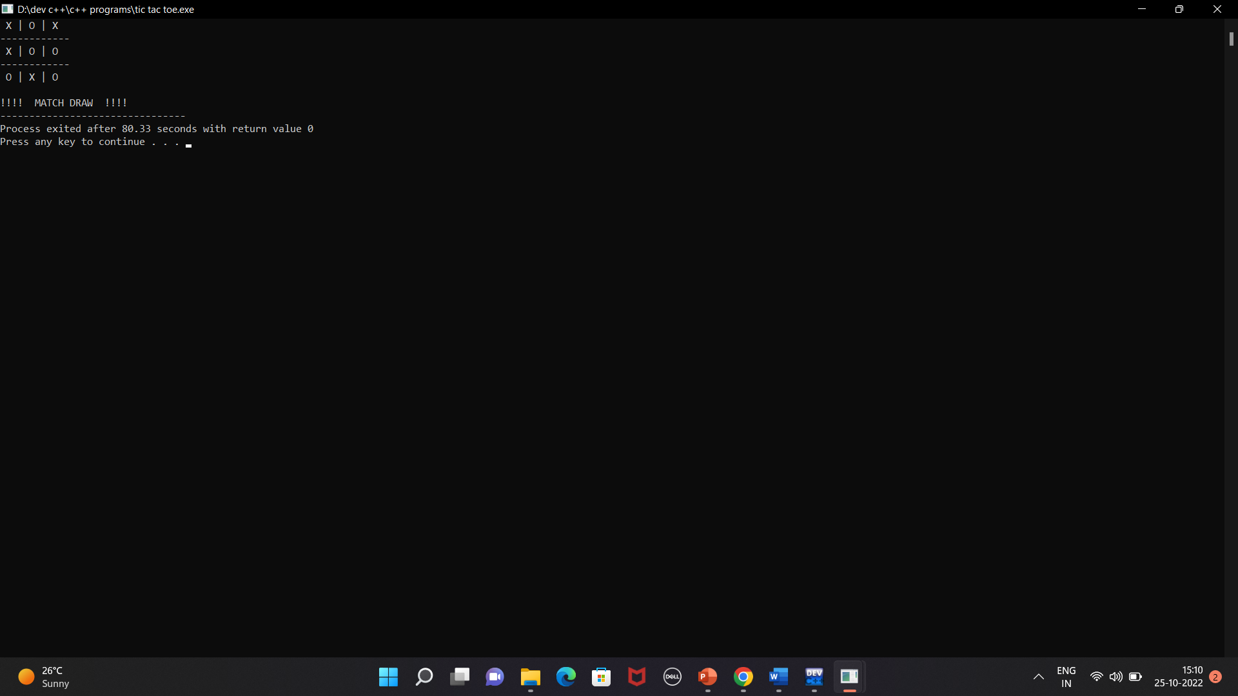
Sample output 1 :-
If the match is drawn :

Slide 10

Sample output 2 :-
If any of the player is won:

Slide 11
Conclusion :-
The Tic Tac Toe game is most familiar among all the age groups. Intelligence can be property of any purpose-driven decision maker . This basic idea has been suggested many times . An algorithm of playing Tic Tac Toe has been presented and tested that works in efficient way. Overall the system works without any bugs .

Slide 12
Future scope of the project :-
Our project will be able to implement in future after making some changes and modifications as we make our project at a very low level . So the modifications that can be done in our project are :
We can connect our program to SQL through which we can store the data of players who won the game multiple times.
We can store the number of winning matches and drawn matches between the two players .

Slide 13
References :-
GeeksforGeeks : https://www.geeksforgeeks.org/c-plus-plus/ .
W3Schools : https://www.w3schools.com/cpp/cpp_intro.asp .
Programiz : https://www.programiz.com/cpp-programming .

Slide 14
Thanks for listening !!

Slide 15
ANY QUERIES ?

